Slide 1

OptimumLap for EV
Michal Podhradsky

Slide 2
Motivation
Optimum Lap simulates behavior of the car on an arbitrary track
Lot of data, including lap time, motor power at any given time, car speed, motor RPM, acceleration etc…
Data can be exported as csv file
For more details look at:
OptimumLap for dummies (and EEs)
EV handbook
All project files are available at https://github.com/podhrmic/OptimumLap-VMS
Please feel free to try it yourself!

Slide 3
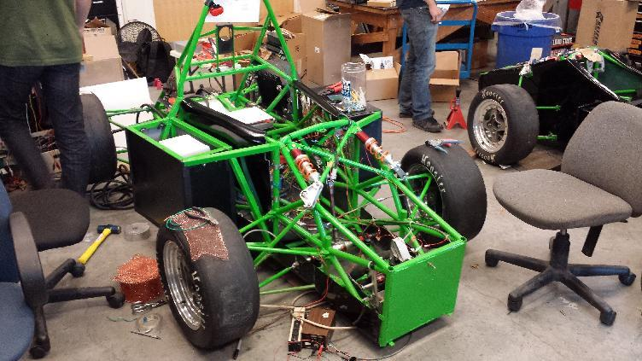
Current car model (EV)

Slide 4
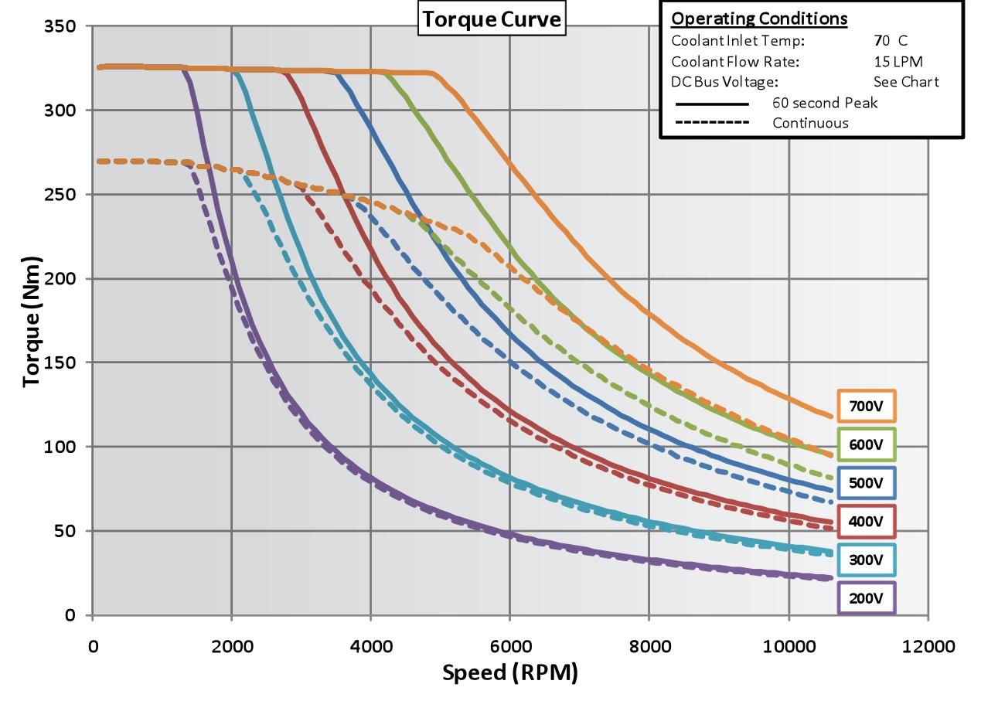
Current car: Remy motor & 4 battery modules (200V)
Remy motor has this torque characteristics:

Slide 5
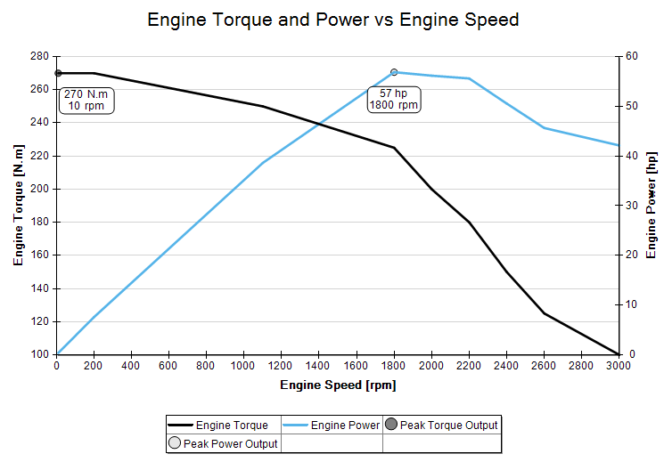
Current car: Remy motor & 4 battery modules (200V)
In OptimumLap:

Slide 6
Current car: Remy motor & 4 battery modules (200V)
Note that Nominal voltage is actually 177V, so the actual torque will be lower than in the datasheet, but we can ignore that for now
We also know that the max RPM we can get with our controller is about 2500 RPM, so we input only relevant data points (up to 3000 RPM)
A quick sanity check - the power profile of the motor should match the power profile from the datasheet

Slide 7
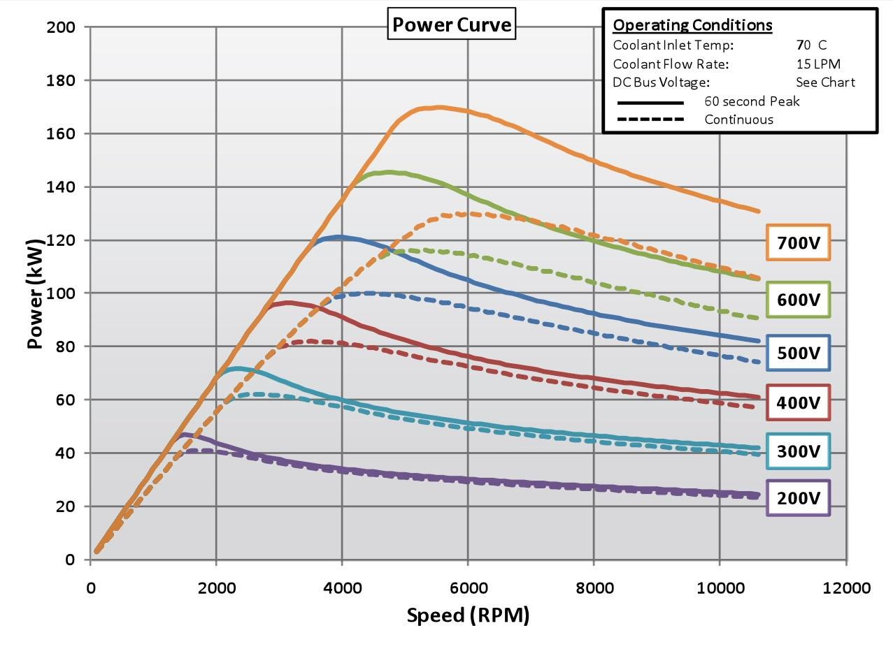
Current car: Remy motor & 4 battery modules (200V)
And it does (again look at 200V curve), 40kw is ~53hp

Slide 8
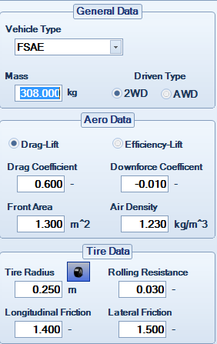
Current car: Remy motor & 4 battery modules (200V)
Car weight: 308 kg (measured)
Aero and tire data taken from default FSAE No Aero model from http://share.optimumg.com/vehicles/?page=2
Thermal efficiency 97% (default)

Slide 9
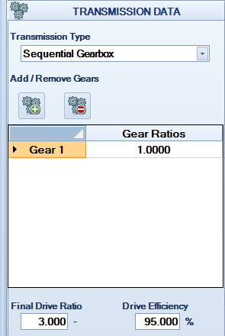
Current car: Remy motor & 4 battery modules (200V)
Only one gear, ratio 1
Final drive ratio: 1:3
gives max speed of 95kmh
Drive efficiency 95% (default)

Slide 10
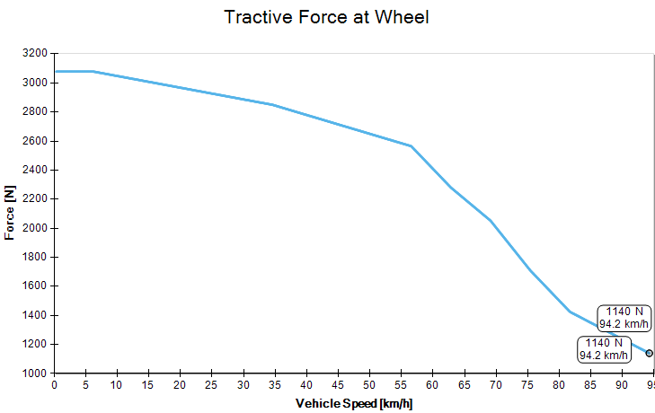
Current car: Remy motor & 4 battery modules (200V)
Looks reasonable, lower at higher speed

Slide 11
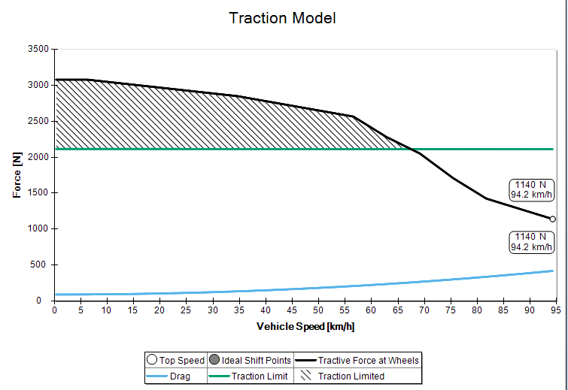
Current car: Remy motor & 4 battery modules (200V)
Somehow reasonable too

Slide 12
Current car: Questions
Are the values all somewhat reasonable?
Max speed?
Acceleration?
Tractive force?
Air drag and roll coefficients?
If so, lets go a step further.

Slide 13
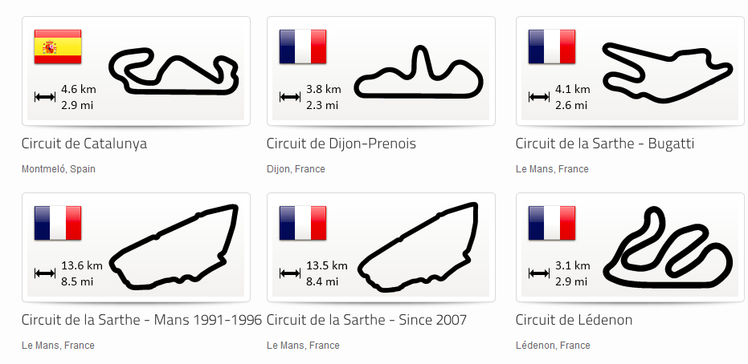
TRACKS

Slide 14

Track: FSAE Endurance, Lincoln, Nebraska 2012
We are most concerned about endurance for EV

Slide 15
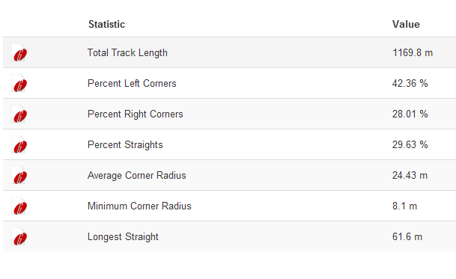
Track: FSAE Endurance, Lincoln, Nebraska 2012
Track report:

Slide 16
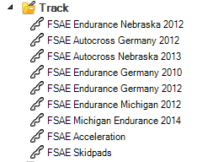
Track: FSAE Endurance, Lincoln, Nebraska 2012
Endurance is ~22 km total, so around 18 rounds of the current track
Also available acceleration, skidpads and autocross tracks

Slide 17
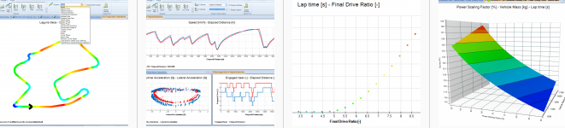
SIMULATION

Slide 18

Simulation
Simulated lap for current EV and for default FSAE No Aero model (for comparison)
The lap times are very similar:
(difference 0.2 s)
EV with Remy motor produces more torque, but IC car has more hp
EV has lower RPM than IC (2000 RPM vs 11000 RPM)
The speed of both cars is quite similar, hence very similar time
Lets look at the results.

Slide 19
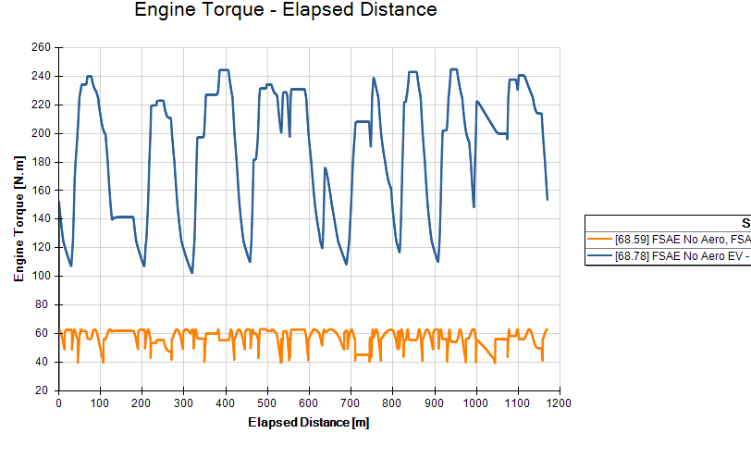
Simulation: Engine Torque

Slide 20
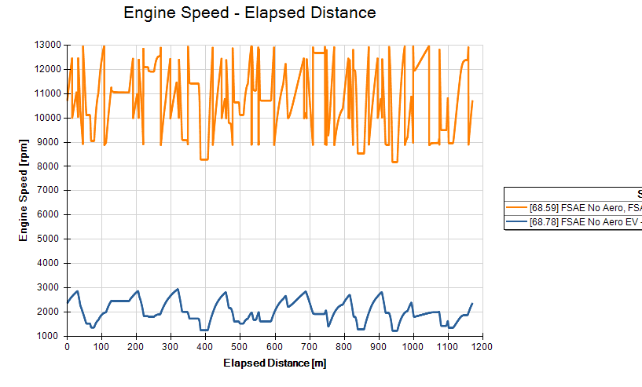
Simulation: Engine RPM

Slide 21
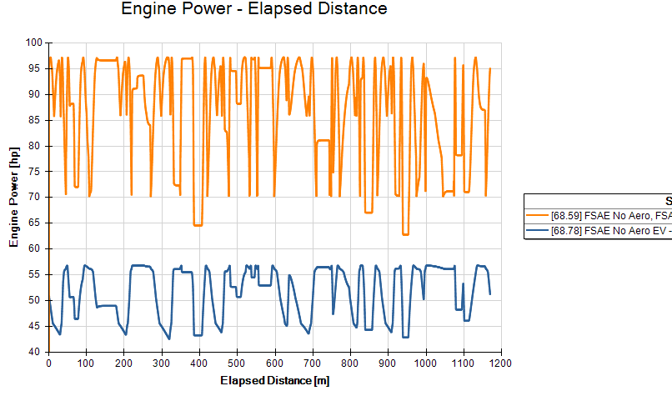
Simulation: Engine Power

Slide 22
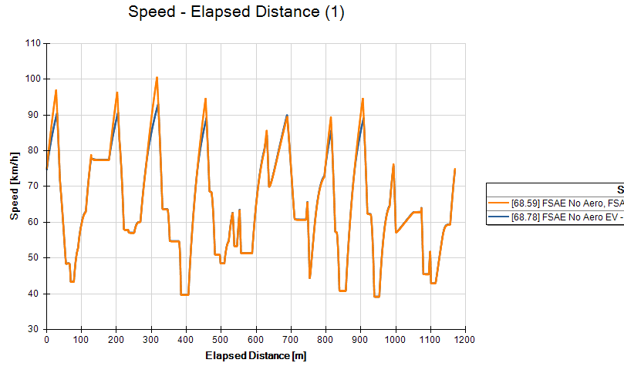
Simulation: Car speed

Slide 23
Simulation Results
So even though EV is heavier and has less powerful motor, it can keep up with the IC car pretty well - so we can expect similar lap time
That is because EV motor produces more torque, and has very hard gear ratio (lot of torque on drivetrain)
What about the current consumption and battery capacity?

Slide 24
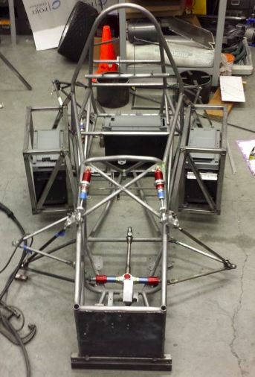
ANALYSIS

Slide 25
Analysis
We know the produced mechanical motor power at any given point (Pme)
Electrical motor power is: Pe = Pme / motor_efficiency [kW]
Motor efficiency greatly varies (from 74% to 97%) and depends on RPM and produced torque. But for now we can assume it to be 90%
The battery power is: Pb = Pe/inverter_efficiency [kW]
Inverter efficiency also varies a bit, so for simplicity we can assume constant losses of 2kw. The equation then will be Pb = Pe + 2 [kW]
We know the system voltage (it depends on state of charge and in this case varies from 120 to 200V), we use the nominal system voltage of 177V (12 cells x 4 battery packs x 3.7 V nominal voltage)
Knowing the voltage, we know the current: Ibat = Pb/Vdc [A]
Integrating the current we get the charge needed to finish one lap

Slide 26
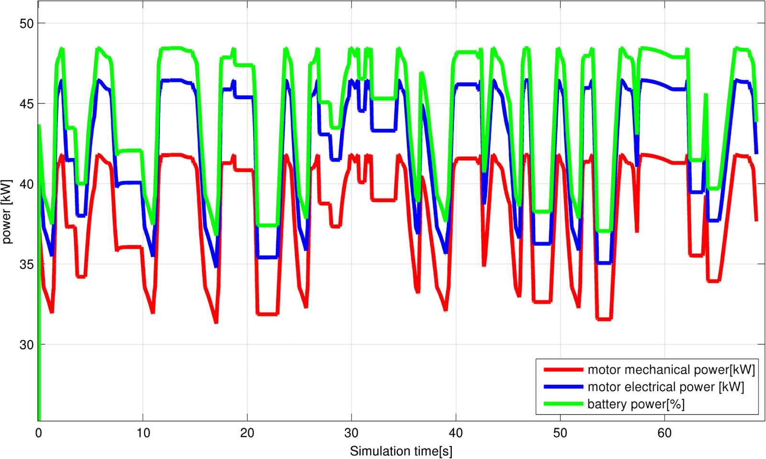
Analysis: Power output

Slide 27
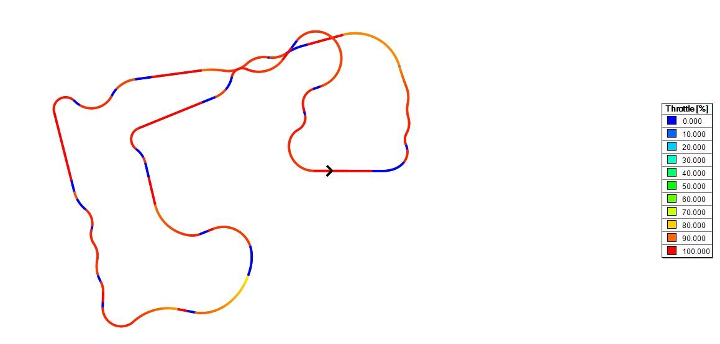
Analysis: a side note
Note that EV doesn’t consume power if the motor is free-spinning (i.e. not producing torque), like during braking or regen
From the track simulation, we use throttle either at 100% or 0% (brake)
So we integrate current only when throttle > 10% (to get more precise estimation)

Slide 28
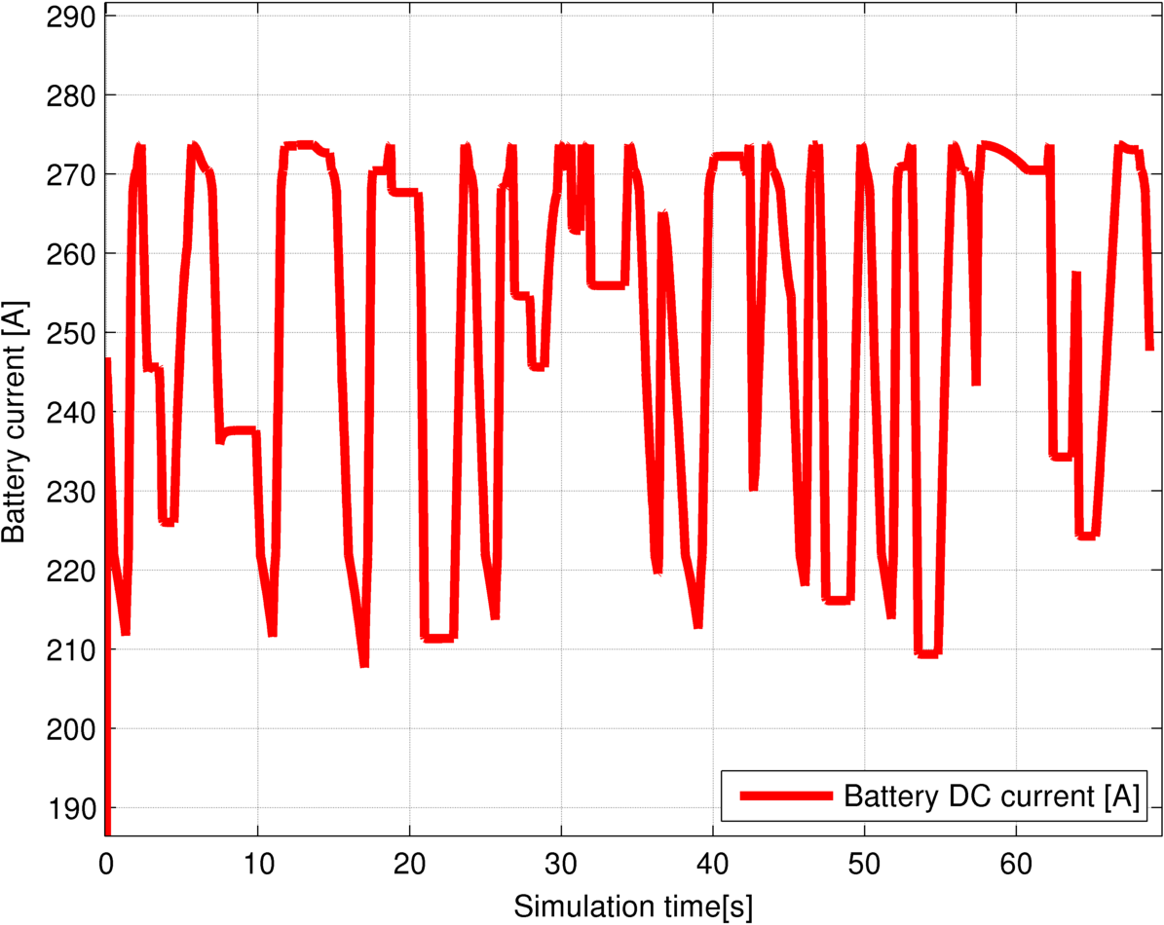
Analysis: current consumption
The integration is done in MATLAB and described in OptimumLap for Dummies (and EEs)
Here is the final plot of DC battery current

Slide 29

Analysis: endurance
The current peaks up to 275[A] (that is OK and within the limit batteries can provide)
Average current consumption is around 210[A]
We have 32[Ah] in the battery packs, so it means if we discharge it at 250[A], the battery will last for 32/210*60 = 9.1 minutes (roughly 8 laps)

Slide 30
summary

Slide 31
Summary
If we want to keep up pace with conventional IC car (no aero, not optimized), we have to discharge batteries at high rate
In that case, endurance will be a problem because we don’t have enough “juice”
Lighter car seems to be beneficial, because less power is needed for acceleration

Slide 32
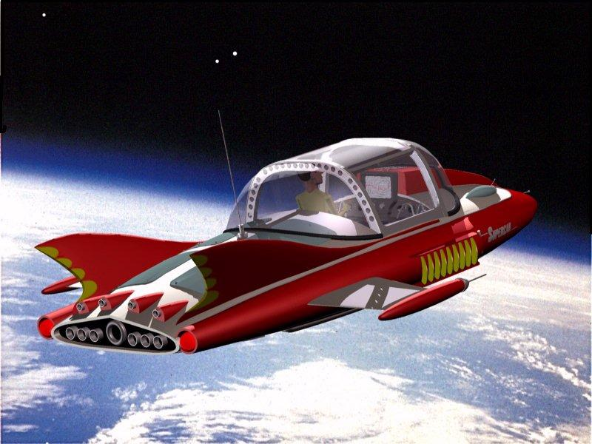
next steps

Slide 33
Next steps
Simulate different combination of motors and batteries (the models are already there) and see what lap time we can get
Calculate endurance with less powerful motors and see the difference
Tamper max produced torque, so the consumption is lower and see how does it compromise the performance
Comments are welcome!

